Slide 1
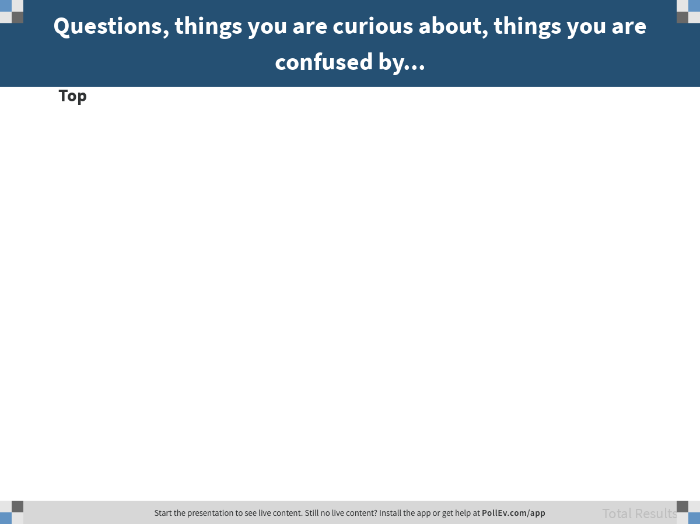
Notes:
Questions, things you are curious about, things you are confused by...
https://www.polleverywhere.com/discourses/tYPkhybiIRvfAnRQwJc43

Slide 2
Quiz #1 – Friday April 12
Look at all practice questions – not just the ones that require R.
Quiz link will come in email to your CCLE email address. Quiz is in this room, and you will get an assigned seat.
Bring device – preferably laptop – for taking quiz. Make sure it is charged!
Notes:
On the spreadsheet called “Simulating Westvaco”

Slide 3
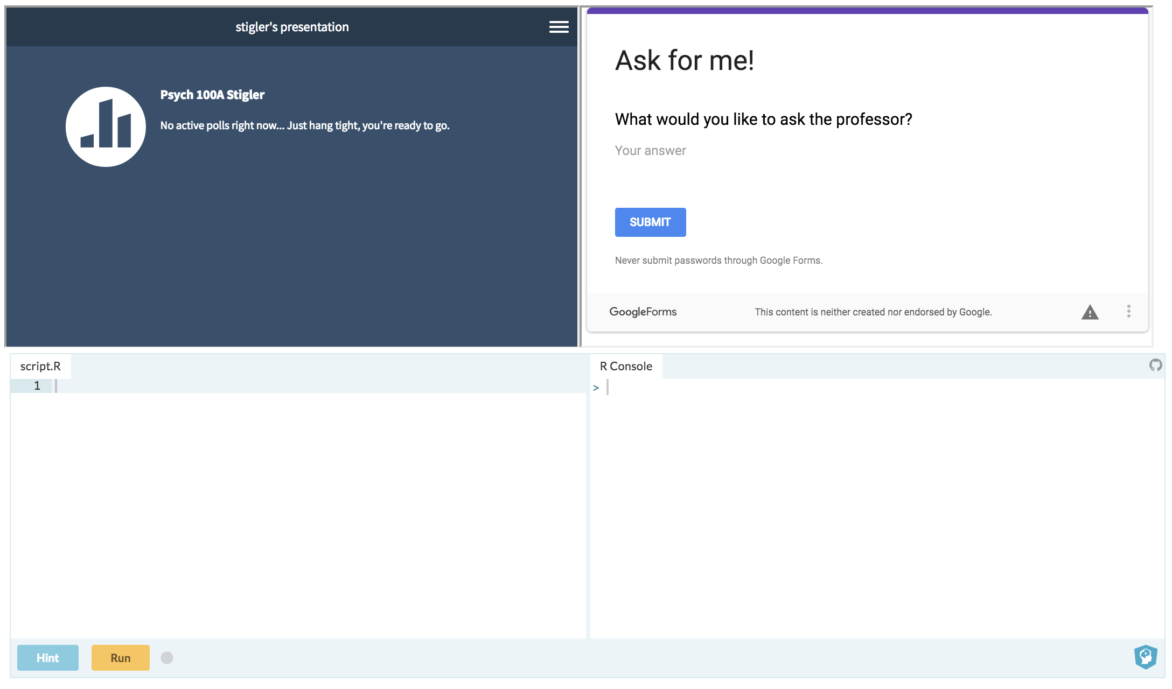
bit.ly/100Aclass

Slide 4
The Whole Thing (continued)
100A Spring 2019 - Stigler
Lecture 3

Slide 5
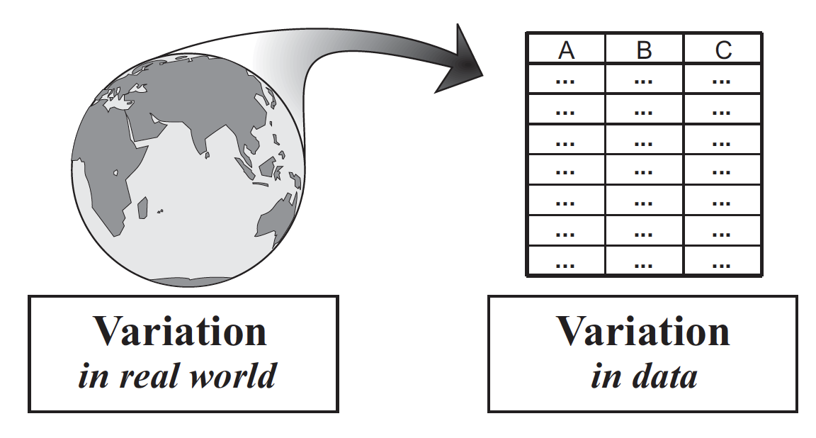
Statistics is the study of variation.
Notes:
Statistics is the study of variation.
We use variation in data to represent variation in world; try to find out about the DGP.

Slide 6
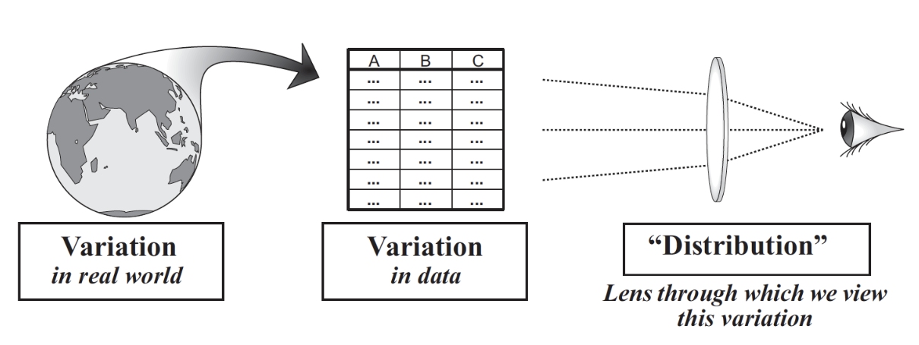
Distribution is the lens through which we view variation.

Slide 7
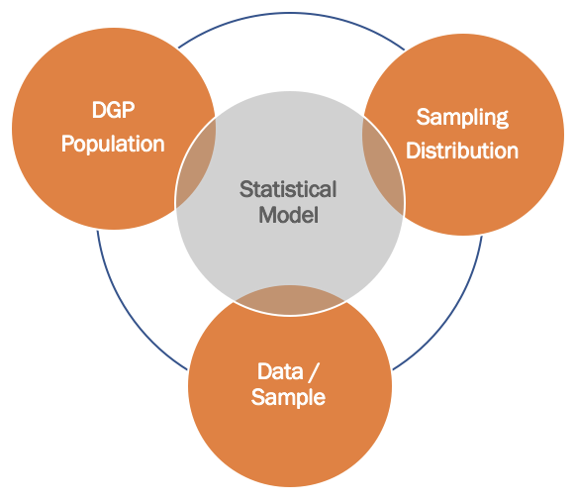
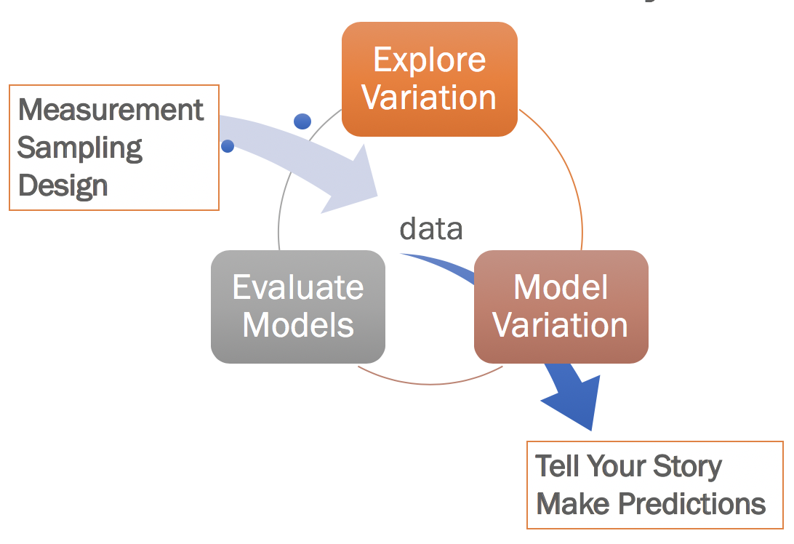
The Whole Thing
We will keep working with the same core ideas again and again. Understanding will come gradually.

Slide 8
Robert Martin was laid off from his job at Westvaco, Inc. soon after he turned 54 years old. He sued for age discrimination.
How do we evaluate his claim?
Martin v. Envelope Div. of Westvaco Corp.,
850 F. Supp. 83 (D. Mass. 1994)

Slide 9
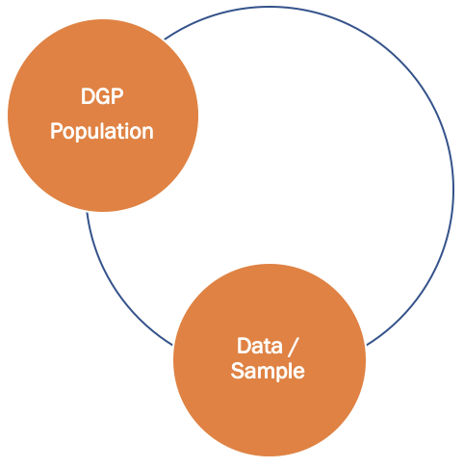
Exploring Variation: Data & DGP

Slide 10
Ages of Employees in One Department (Laid Off in Blue)
25, 33, 35, 38, 48,
55, 55, 55, 56, 64
Do you think the data supports the claim of age discrimination?

Slide 11
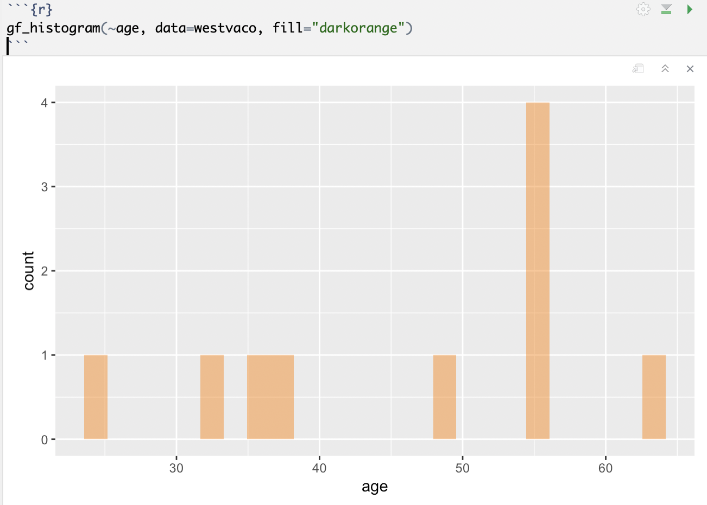

Slide 12
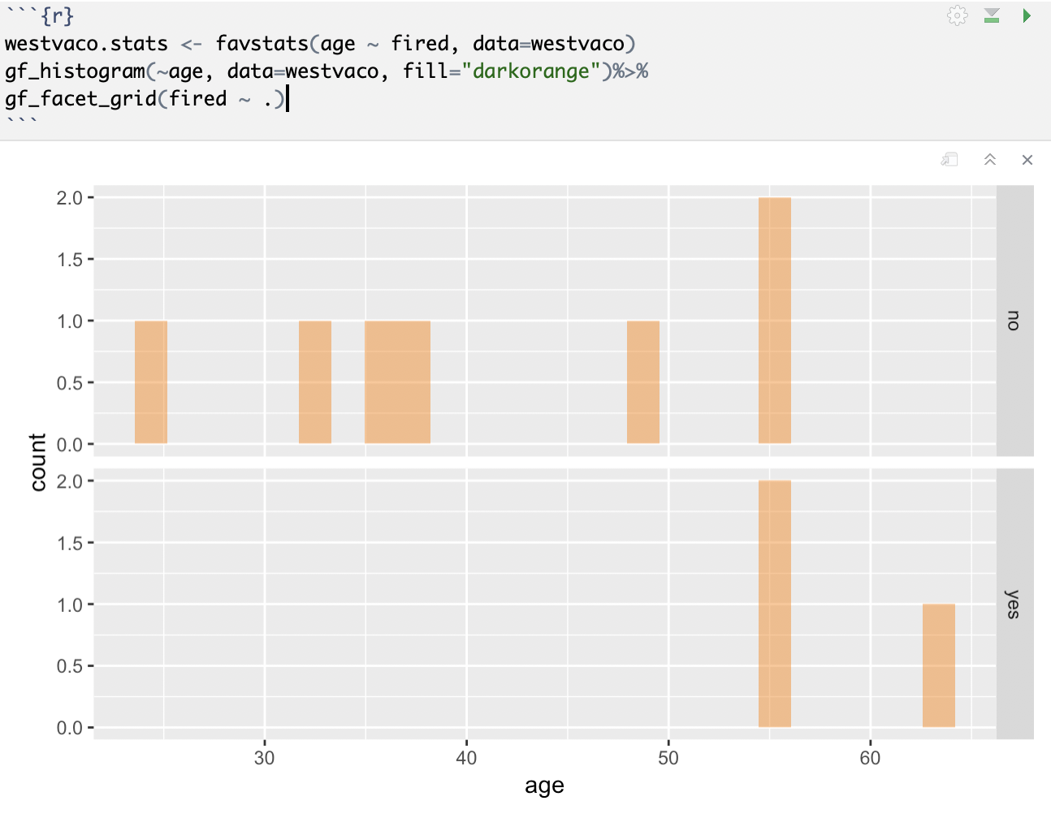

Slide 13
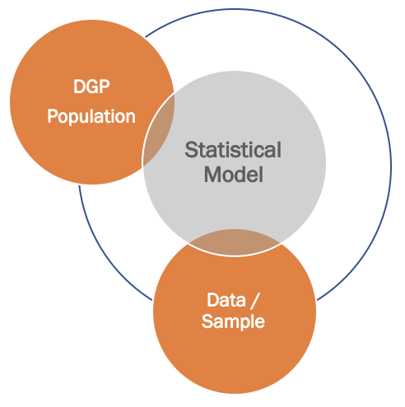
Modeling Data & DGP

Slide 14
Informal models: Word equations
What possible DGPs could have produced this distribution?

Slide 15
Model Variation
Fired = Age + Other Stuff
Fired = Experience + Other Stuff
…
Fired = Other Stuff
DATA = MODEL + ERROR

Slide 16
Model Comparison: Can We Rule Out the Purely Random Model?
fired = age + other stuff
fired = other stuff
empty model
(null)
If we can rule out the simpler model, we will need to go with the more complex one.
You can’t judge randomness by just looking at a single outcome (in poker, “resulting”).
Notes:
On the spreadsheet called “Simulating Westvaco”

Slide 17
We know how to model purely random processes. Using the tools of statistics…
We ask: IF purely random model is true, what is the likelihood of getting a data distribution that looks like the one we got?
Analogous to the coin flip: If we only have one outcome, we can’t tell how likely a particular outcome is; but if we have many, then we can have a better idea.
Notes:
Relate to model comparison, and null hypothesis

Slide 18
Simulating Randomness
Adding in Sampling Distributions

Slide 19
Next year: be sure to bring up the concept of sampling variation… that’s what we are modeling through our random process.

Slide 20
Simulating Random Process
Simulate process
Construct summary of outcome
Repeat
How to simulate random DGP for Westvaco?

Slide 21
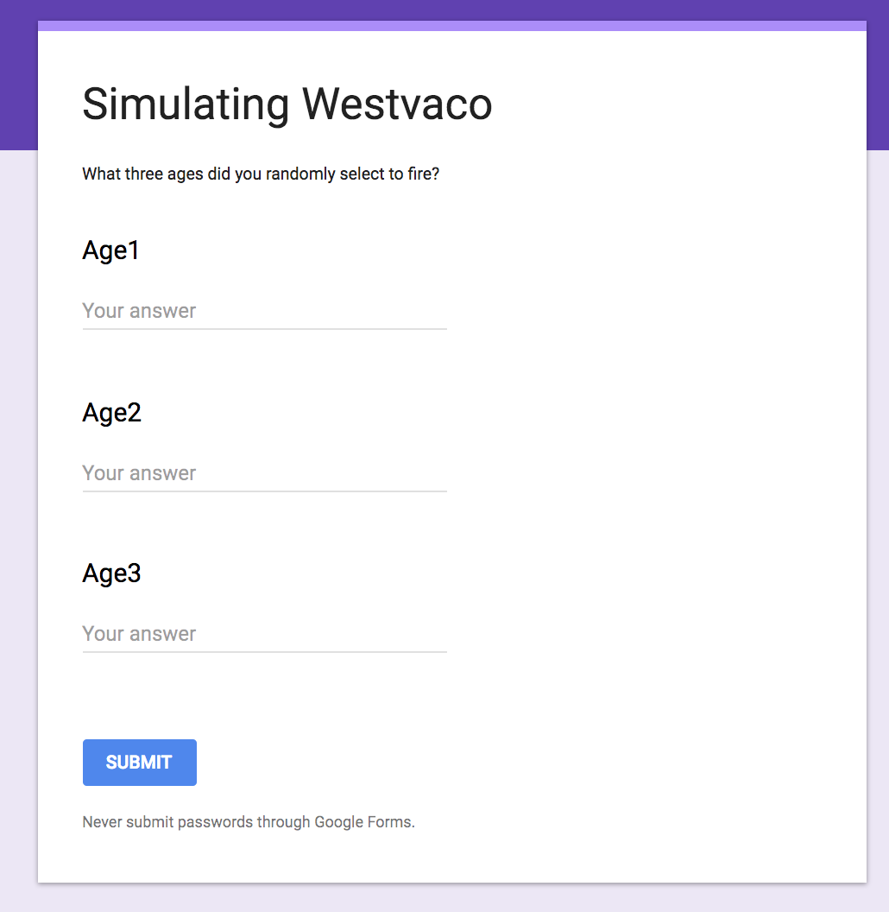
Simulation
Construct materials
10 pieces of paper, each with one of the ages
Simulate random selection of 3 to fire
Enter your three selected ages: bit.ly/randomages
25, 33, 35, 38, 48,
55, 55, 55, 56, 64

Slide 22
Draw what you expect the data table to look like if we put this data in tidy format.
Notes:
On the spreadsheet called “Simulating Westvaco”

Slide 23
Let’s pull your random data into DataCamp.
westvaco.sim <- read.csv
("http://bit.ly/westvacosimulation", header=TRUE)
Notes:
On the spreadsheet called “Simulating Westvaco”

Slide 24
Examine the first 6 rows of the data frame. What is each row? What can you see by examining the data?
Notes:
On the spreadsheet called “Simulating Westvaco”

Slide 25
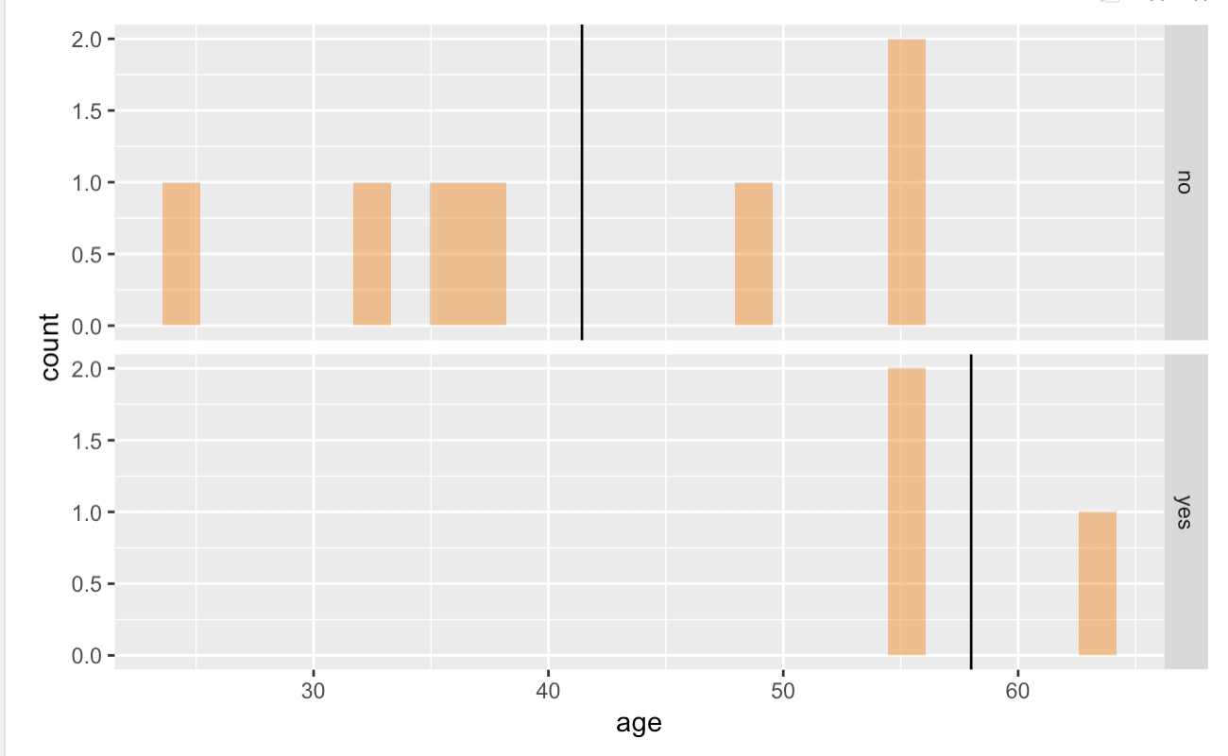
Finding a simple summary statistic
Let’s use this!
Mean Fired: 58.0
Not Fired: 41.4
Difference: 16.6

Slide 26
Use R to create a summary of each random draw (the mean age of those fired).
Notes:
On the spreadsheet called “Simulating Westvaco”

Slide 27
Now let’s use R to examine the distribution of random draws.
Notes:
On the spreadsheet called “Simulating Westvaco”

Slide 28
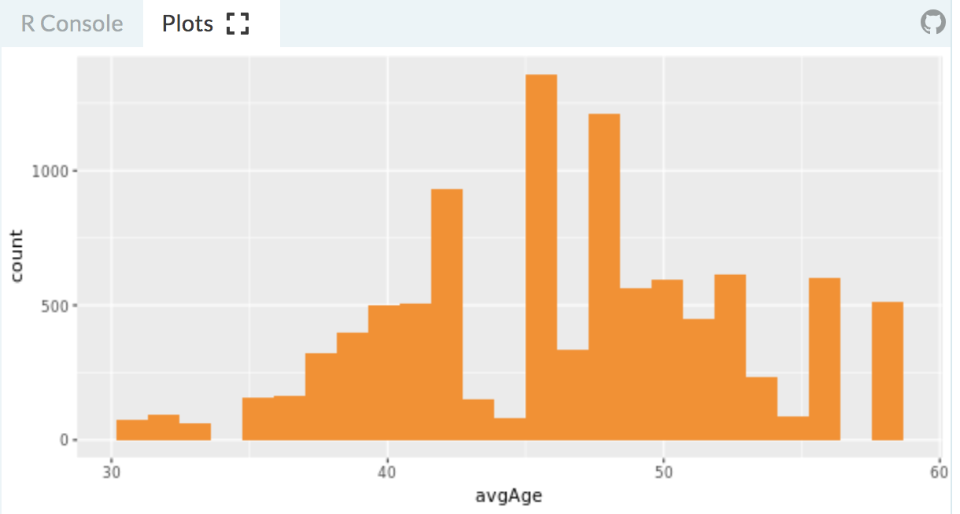

Sampling Distribution
What does the count on the x axis refer to?

Slide 29
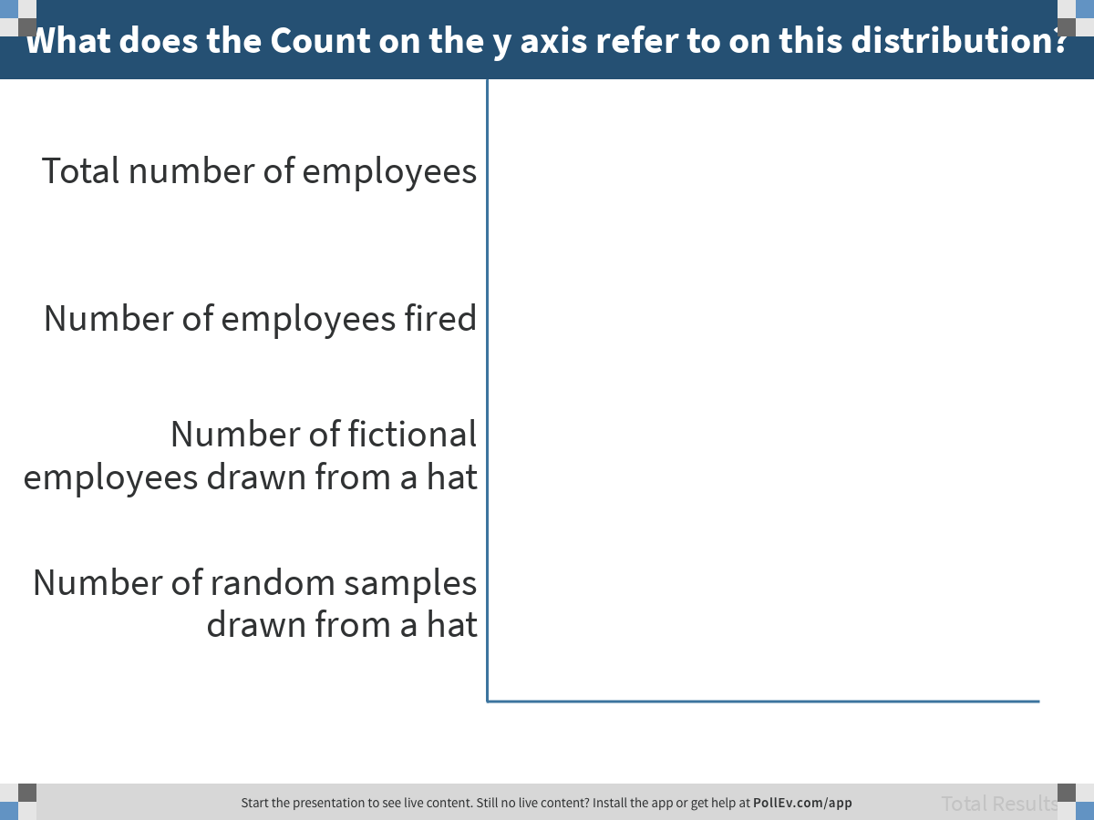
Notes:
What does the Count on the y axis refer to on this distribution?
https://www.polleverywhere.com/multiple_choice_polls/WIvQdGbmI0F2MqPawO85x

Slide 30
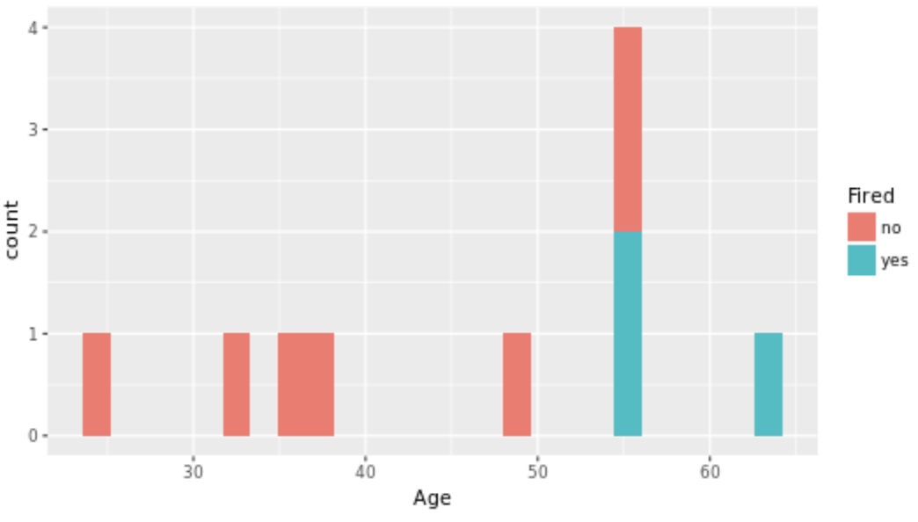
Sampling vs Data Distribution
Where are fired employees represented in each graph?
Data
x axis?
y axis?
Sampling

Slide 31
Back to our Model Comparison Question
fired = age + other stuff
versus
fired = other stuff
Empty Model /
Null Hypothesis
IF the DGP is random, what is the likelihood that the average age of those fired would be 58 (as observed) or greater?

Slide 32
IF DGP is Random…
meanFired >= 58
What is probability of getting a sample with meanFired >= 58?

Slide 33
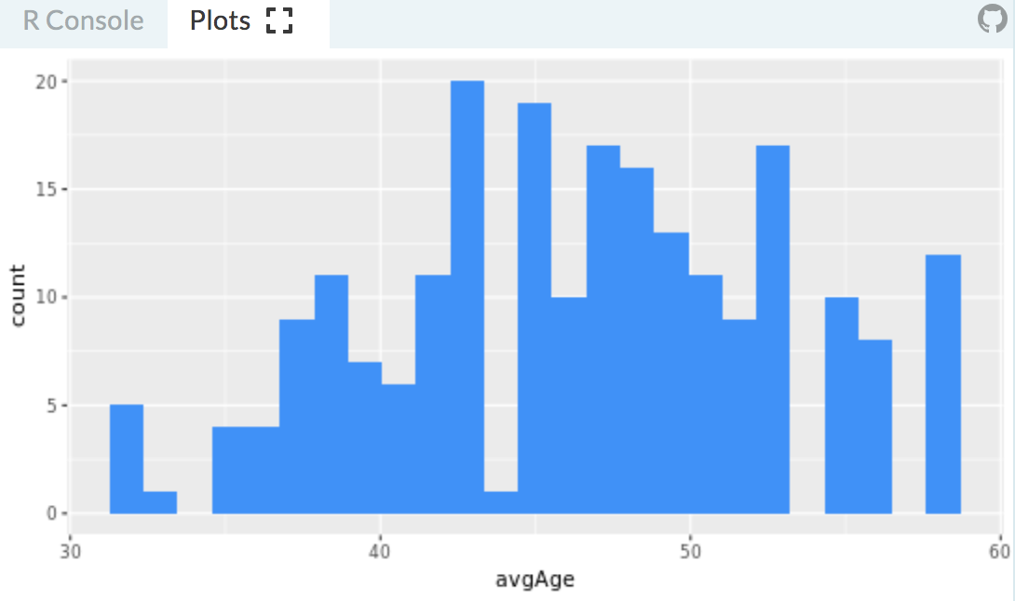
Sampling Distribution is a Probability Distribution
What is the probability of selecting a sample with mean age >= 58?
Draw a picture to represent this question.

Slide 34
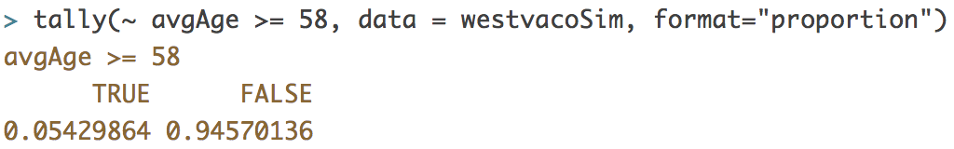
Sampling Distribution is a Probability Distribution
What is the probability of selecting a sample with mean age >= 58?

Slide 35
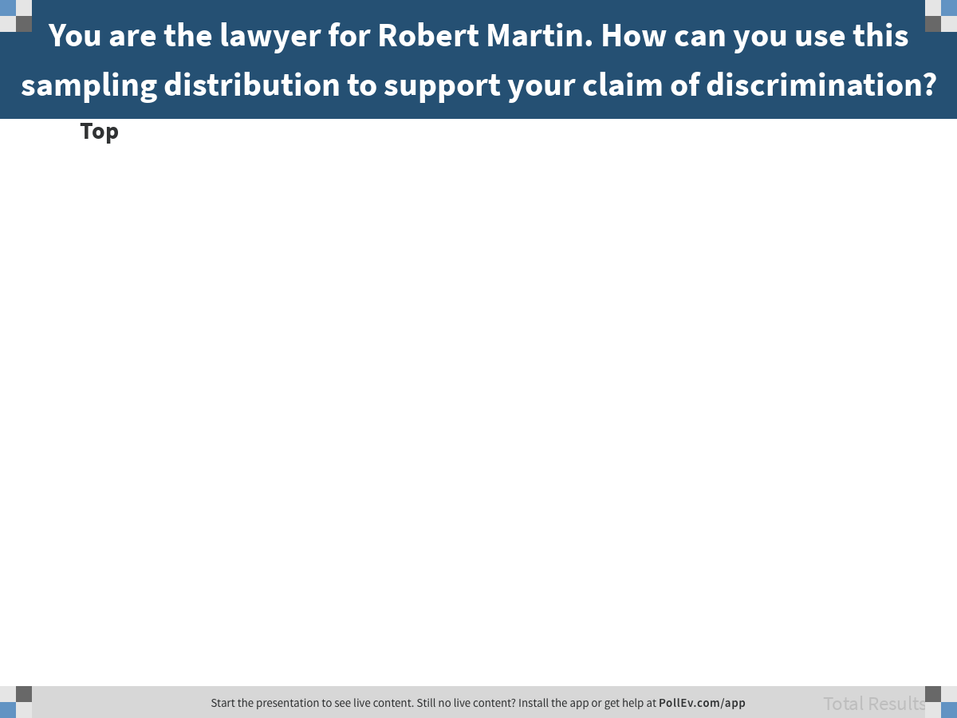
Notes:
You are the lawyer for Robert Martin. How can you use this sampling distribution to support your claim of discrimination?
https://www.polleverywhere.com/discourses/d3MiFqAFnlrz0yovnbBm4

Slide 36
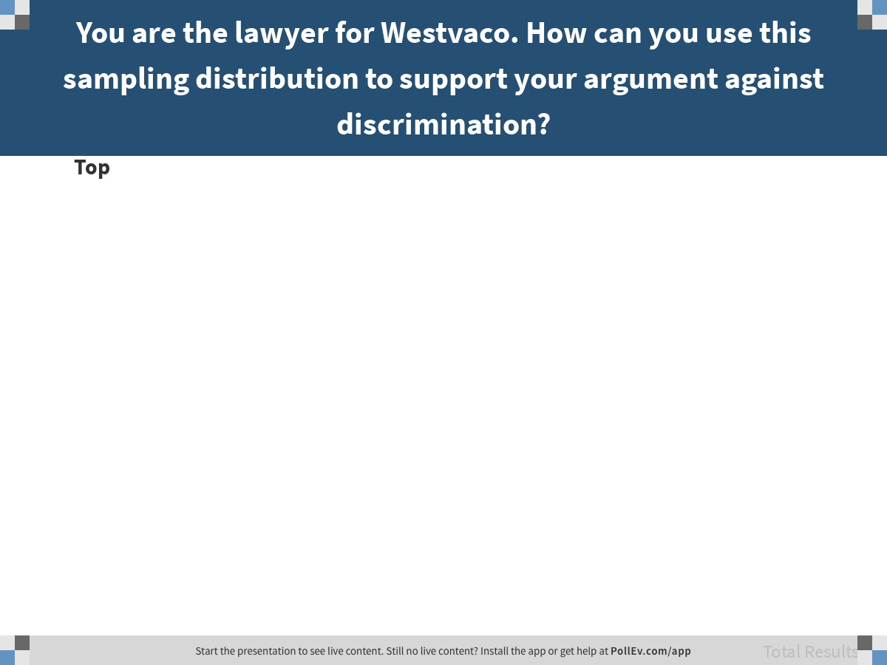
Notes:
You are the lawyer for Westvaco. How can you use this sampling distribution to support your argument against discrimination?
https://www.polleverywhere.com/discourses/0ZnnFyj1ICzjEsm054J0M

